Slide 1

A brief history of Natural Language Processing
George Margaritis & Periklis Petridis
15.S60 - IAP 2024

Slide 2
NLP: Text Classification
Text
Label
Is the sentence positive or negative?
“The movie was terrible.”
“Amazing movie!”
0
1
Applications of text classification:
Fake news detection
Sentiment Analysis (e.g. find if review are positive/negative)
Document Categorization
Medical Record analysis (e.g. make diagnosis from medical text)
….

Slide 3
NLP: Text Classification
Text
Label
“The movie was terrible”
“Amazing movie!”
0
1
Problems with Natural Language Processing (NLP):
Computers don’t understand language
Human language has a lot of variability ≠ Programming languages

Slide 4
NLP: Text Classification
Text
Embeddings
Label
Supervised ML model
Predict
0
“The movie was terrible”
“Amazing movie!”
0.2
1.3
0
1
1.2
0.4
Problems with Natural Language Processing (NLP):
Computers don’t understand language
Human language has a lot of variability ≠ Programming languages
General idea:
Convert text to a meaningful vector representation (embedding)
Use a model (e.g. NN) to classify those vectors

Slide 5
2013-2014
Ways for creating dense low-dimensional word embeddings
2017
Superseded RNNs and completely took over the field of NLP
2018
Generative Pretrained Transformer which is the first ancestor of ChatGPT
Bag of Words
Word2Vec/ GloVe
RNNs
Transformers
BERT
GPT-1
1954
Very simple and contextless way of vectorizing text
~2015
Introduced in early 90’s but took off in mid 2010s due to DL advances
2018
Transformer-based architecutres for high-quality, contextualized embeddings

Slide 6
2013-2014
Ways for creating dense low-dimensional word embeddings
2017
Superseded RNNs and completely took over the field of NLP
2018
Generative Pretrained Transformer which is the first ancestor of ChatGPT
Bag of Words
Word2Vec/ GloVe
RNNs
Transformers
BERT
GPT-1
1954
Very simple and contextless way of vectorizing text
~2015
Introduced in early 90’s but took off in mid 2010s due to DL advances
2018
Transformer-based architecutres for high-quality, contextualized embeddings

Slide 7
Bag Of Words (BoW)
Fundamental NLP technique (1954)
Advantages:
Simple to understand & implement
Very efficient
In some tasks can outperform much more advanced techniques
Good initial baseline

Slide 8
BoW: Text Classification
Text
Label
Training set:
“The cat sat on the mat.”
“I love you.”
0
1
Is the sentence positive or neutral?

Slide 9
BoW Step 1: Create a dictionary
Index | Word
0 | [PAD]
1 | [UNK]
2 | cat
3 | mat
4 | I
5 | sit
6 | love
7 | the
8 | you
9 | on
“The cat sat on the mat. I love you.”
To lowercase
Remove punctuation
Stem
Tokenize
“the”, “cat”, “sit”, “on”, “the”, “mat”, “I”, “love”, “you”

Slide 10
BoW Step 2: Vectorization
Index | Word
0 | [PAD]
1 | [UNK]
2 | cat
3 | mat
4 | I
5 | sit
6 | love
7 | the
8 | you
9 | on
The cat sat on the mat.
7 2 5 9 7 3

Slide 11
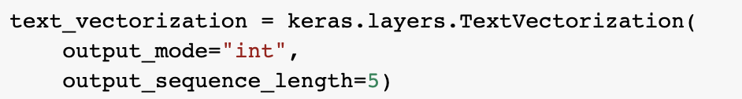
Step 2: Vectorization
Index | Word
0 | [PAD]
1 | [UNK]
2 | cat
3 | mat
4 | I
5 | sit
6 | love
7 | the
8 | you
9 | on
6)
int: index sequence
output_sequence_length: a fixed length for output
I love you!
4 6 8 0 0 0

Slide 12
BoW Step 2: Vectorization
Index | Word
0 | [PAD]
1 | [UNK]
2 | cat
3 | mat
4 | I
5 | sit
6 | love
7 | the
8 | you
9 | on
The dog likes the sofa
7 1 1 7 1

Slide 13
BoW Step 3: Encoding
Index
0
1
2
3
4
5
6
7
8
9
The cat sat on the mat
0
0
0
0
0
0
0
1
0
0
0
0
1
0
0
0
0
0
0
0
0
0
0
0
0
1
0
0
0
0
0
0
0
0
0
0
0
0
0
1
0
0
0
0
0
0
0
1
0
0
0
0
0
1
0
0
0
0
0
0
+
+
+
+
+
=
7
2
5
9
7
3

Slide 14
BoW Step 3: Encoding
Index
0
1
2
3
4
5
6
7
8
9
The cat sat on the mat
0
0
0
0
0
0
0
1
0
0
0
0
1
0
0
0
0
0
0
0
0
0
0
0
0
1
0
0
0
0
0
0
0
0
0
0
0
0
0
1
0
0
0
0
0
0
0
1
0
0
0
0
0
1
0
0
0
0
0
0
0
0
1
1
0
1
0
2
0
1
+
+
+
+
+
=
7
2
5
9
7
3

Slide 15
BoW: Train Model
Feature vector (x)
0
0
1
1
0
1
0
2
0
1
The cat sat on the mat
Train model
Supervised ML model
Predict
0
Label (y)
0

Slide 16
Disadvantages of BoW

Slide 17
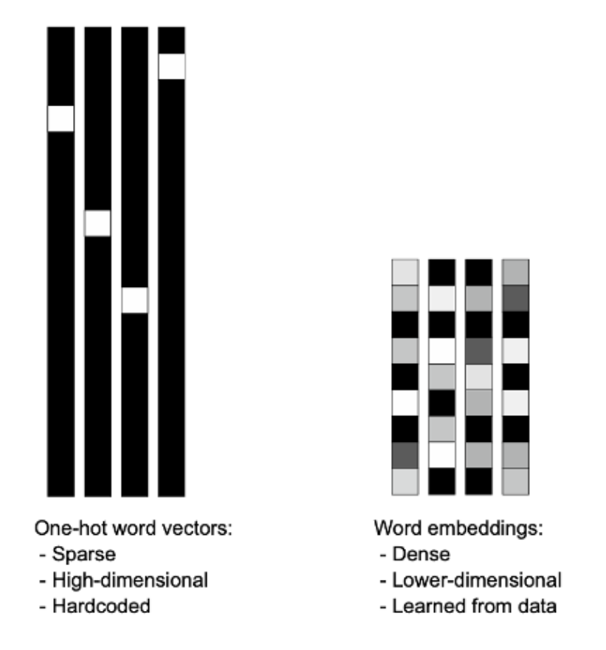
Disadvantages of BoW
Very long vectors (number of unique words)
Doesn’t take context & word order into account
Distance of BoW vectors always the same

Slide 18
2013-2014
Ways for creating dense low-dimensional word embeddings
2017
Superseded RNNs and completely took over the field of NLP
2018
Generative Pretrained Transformer which is the first ancestor of ChatGPT
Bag of Words
Word2Vec/ GloVe
RNNs
Transformers
BERT
GPT-1
1954
Very simple and contextless way of vectorizing text
~2015
Introduced in early 90’s but took off in mid 2010s due to DL advances
2018
Transformer-based architecutres for high-quality, contextualized embeddings

Slide 19
GloVe embeddings
GloVe, or Global Vectors for Word Representation (2014)
Represent words in low-dimensional continuous vector spaces
Capture semantic relationships between words:
Words that are “close” semantically have similar embeddings (e.g. “MIT” and “Caltech”)

Slide 20

GloVe: Word co-occurrence matrix
“The cat sat on the mat.”
“The cat loves you.”
 | the | cat | sit | on | mat | love | you
the | 2 | 2 | 1 | 1 | 1 | 1 | 1
cat | 2 | 2 | 1 | 1 | 1 | 1 | 1
sit | 1 | 1 | 1 | 1 | 1 | 0 | 0
on | 1 | 1 | 1 | 1 | 1 | 0 | 0
mat | 1 | 1 | 1 | 1 | 1 | 0 | 0
love | 1 | 1 | 0 | 0 | 0 | 1 | 1
you | 1 | 1 | 0 | 0 | 0 | 1 | 1
To lowercase
Remove punctuation
Stem
Tokenize
“the”, “cat”, “sit”, “on”, “the”, “mat”
“the”, “cat”, “love”, “you”
$$X_{ij}:$$
# times word i appears in the same context as word j

Slide 21

GloVe: Word co-occurrence matrix
Embedding of i-th word
 | the | cat | sit | on | mat | love | you
the | 2 | 2 | 1 | 1 | 1 | 1 | 1
cat | 2 | 2 | 1 | 1 | 1 | 1 | 1
sit | 1 | 1 | 1 | 1 | 1 | 0 | 0
on | 1 | 1 | 1 | 1 | 1 | 0 | 0
mat | 1 | 1 | 1 | 1 | 1 | 0 | 0
love | 1 | 1 | 0 | 0 | 0 | 1 | 1
you | 1 | 1 | 0 | 0 | 0 | 1 | 1
$$\log\left(X_{ij}\right)=b_{i}+b_{j}+w_{i}^{T}w_{j}$$
Data
Trainable
params
$$X_{ij}:$$
# times word i appears in the same context as word j

Slide 22
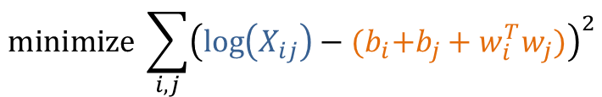
GloVe: Word co-occurrence matrix
Embedding of i-th word
 | the | cat | sit | on | mat | love | you
the | 2 | 2 | 1 | 1 | 1 | 1 | 1
cat | 2 | 2 | 1 | 1 | 1 | 1 | 1
sit | 1 | 1 | 1 | 1 | 1 | 0 | 0
on | 1 | 1 | 1 | 1 | 1 | 0 | 0
mat | 1 | 1 | 1 | 1 | 1 | 0 | 0
love | 1 | 1 | 0 | 0 | 0 | 1 | 1
you | 1 | 1 | 0 | 0 | 0 | 1 | 1
$$\log\left(X_{ij}\right)=b_{i}+b_{j}+w_{i}^{T}w_{j}$$
Data
Trainable
params
$$minimize \sum_{i,j}{{\left(\log\left(X_{ij}\right)−{(b}_{i}+b_{j}+w_{i}^{T}w_{j})\right)}^{2}}$$
$$X_{ij}:$$
# times word i appears in the same context as word j

Slide 23
GloVe: Embeddings Encoding
Cat sat on the mat: 2 5 9 7 3
Index | Word | Embedding wi
0 | ‘’ | 1.3 | 2.5
1 | [UNK] | 6.1 | -3.2
2 | cat | 0.5 | 7.1
3 | mat | -2 | -3.1
4 | I | 0.1 | 3.4
5 | sit | 1.2 | 5.3
6 | love | 6.1 | 7.2
7 | the | 0.1 | 0.1
8 | you | 5.0 | 3.2
9 | on | 2.0 | 4.1
Index | Embedding
2
5
9
7
3

Slide 24
GloVe: Embeddings Encoding
Cat sat on the mat: 2 5 9 7 3
Index | Word | Embedding wi
0 | ‘’ | 1.3 | 2.5
1 | [UNK] | 6.1 | -3.2
2 | cat | 0.5 | 7.1
3 | mat | -2 | -3.1
4 | I | 0.1 | 3.4
5 | sit | 1.2 | 5.3
6 | love | 6.1 | 7.2
7 | the | 0.1 | 0.1
8 | you | 5.0 | 3.2
9 | on | 2.0 | 4.1
Index | Embedding
2 | 0.5 | 7.1
5 | 1.2 | 5.3
9 | 2.0 | 4.1
7 | 0.1 | 0.1
3 | -2 | -3.1

Slide 25
GloVe : Embeddings Encoding
Cat sat on the mat: 2 5 9 7 3
Index | Word | Embedding wi
0 | ‘’ | 1.3 | 2.5
1 | [UNK] | 6.1 | -3.2
2 | cat | 0.5 | 7.1
3 | mat | -2 | -3.1
4 | I | 0.1 | 3.4
5 | sit | 1.2 | 5.3
6 | love | 6.1 | 7.2
7 | the | 0.1 | 0.1
8 | you | 5.0 | 3.2
9 | on | 2.0 | 4.1
Index | Embedding
2 | 0.5 | 7.1
5 | 1.2 | 5.3
9 | 2.0 | 4.1
7 | 0.1 | 0.1
3 | -2 | -3.1
average | 0.36 | 2.7

Slide 26
GloVe Embeddings: Algebra
Index | Word | Embedding wi
0 | ‘’ | 1.3 | 2.5
1 | [UNK] | 6.1 | -3.2
2 | cat | 0.5 | 7.1
3 | mat | -2 | -3.1
4 | I | 0.1 | 3.4
5 | sit | 1.2 | 5.3
6 | love | 6.1 | 7.2
7 | the | 0.1 | 0.1
8 | you | 5.0 | 3.2
9 | on | 2.0 | 4.1
person + moustache = ?

Slide 27
GloVe Embeddings: Algebra
Index | Word | Embedding wi
0 | ‘’ | 1.3 | 2.5
1 | [UNK] | 6.1 | -3.2
2 | cat | 0.5 | 7.1
3 | mat | -2 | -3.1
4 | I | 0.1 | 3.4
5 | sit | 1.2 | 5.3
6 | love | 6.1 | 7.2
7 | the | 0.1 | 0.1
8 | you | 5.0 | 3.2
9 | on | 2.0 | 4.1
person + moustache = man!

Slide 28
GloVe Embeddings: Analogies
Index | Word | Embedding wi
0 | ‘’ | 1.3 | 2.5
1 | [UNK] | 6.1 | -3.2
2 | cat | 0.5 | 7.1
3 | mat | -2 | -3.1
4 | I | 0.1 | 3.4
5 | sit | 1.2 | 5.3
6 | love | 6.1 | 7.2
7 | the | 0.1 | 0.1
8 | you | 5.0 | 3.2
9 | on | 2.0 | 4.1
brother – man = sister - woman

Slide 29
GloVe Embeddings: Analogies
Index | Word | Embedding wi
0 | ‘’ | 1.3 | 2.5
1 | [UNK] | 6.1 | -3.2
2 | cat | 0.5 | 7.1
3 | mat | -2 | -3.1
4 | I | 0.1 | 3.4
5 | sit | 1.2 | 5.3
6 | love | 6.1 | 7.2
7 | the | 0.1 | 0.1
8 | you | 5.0 | 3.2
9 | on | 2.0 | 4.1
brother – man = sister - woman

Slide 30
Colab
Link

Slide 31
Disadvantages of GloVe
Doesn’t account for word order:
“The exceptional character development overshadows the dull storyline”
“The dull storyline overshadows the exceptional character development”
Words have same embedding independently of the context:
“The sky is blue”
“I am feeling blue”

Slide 32
2013-2014
Ways for creating dense low-dimensional word embeddings
2017
Superseded RNNs and completely took over the field of NLP
2018
Generative Pretrained Transformer which is the first ancestor of ChatGPT
Bag of Words
Word2Vec/ GloVe
RNNs
Transformers
BERT
GPT-1
1954
Very simple and contextless way of vectorizing text
~2015
Introduced in early 90’s but took off in mid 2010s due to DL advances
2018
Transformer-based architecutres for high-quality, contextualized embeddings

Slide 33
Recurrent Neural Networks (RNNs)
Neural Networks specializing in sequence modeling:
Natural language processing
Time series prediction
Speech recognition
…
Developed in the 90s ≠ Became very popular in mid 2010s
Many variations:
LSTMs
GRUs
Bidirectional RNNs

Slide 34
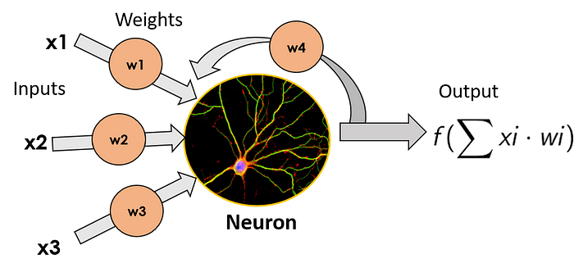



Recurrent Neural Networks (RNNs)
Standard
Neuron
$${ h}_{t}$$
$$h_{t}=f(w_{1}x_{1}+w_{2}x_{2}+w_{3}x_{3})$$
Output depends on
previous state
RNN Neuron
(feedback
connection)
$${ h}_{t}$$
$$h_{t}=f(w_{1}x_{1}+w_{2}x_{2}+w_{3}x_{3}+w_{4}h_{t−1})$$

Slide 35









Recurrent Neural Networks (RNNs)
$$h_{t}$$
$$h_{0}$$
$$h_{1}$$
$$h_{2}$$
Unroll
f
f
f
f
Final output
$$h_{t−1}$$
$${ x}^{(t)}$$
$${ x}^{(0)}$$
$${ x}^{(1)}$$
$${ x}^{(2)}$$
“Dogs”
“love”
“food”
Context & word order matters!
time 0
time 1
time 2

Slide 36
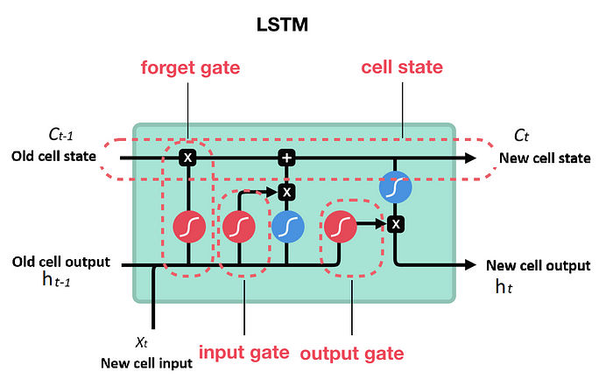
RNN Challenges
Vanishing gradient problem:
Gradients corresponding to older time steps become exponentially small
RNN cell quickly forgets old information
→ No long-term memory
Solution:
Long Short-Term memory cells (LSTMs)
Have memory to remember longer sequences
Have gates to controw the flow of information to and from the memory

Slide 37
RNN Challenges
LSTMs mitigate the vanishing/exploding gradient problem:
Not completely overcome it
Still issues with longer sequences
All RNNs process data sequentially:
Tokens must be passed one by one
No parallelization!
Transformers address both of those problems!

Slide 38
2013-2014
Ways for creating dense low-dimensional word embeddings
2017
Superseded RNNs and completely took over the field of NLP
2018
Generative Pretrained Transformer which is the first ancestor of ChatGPT
Bag of Words
Word2Vec/ GloVe
RNNs
Transformers
BERT
GPT-1
1954
Very simple and contextless way of vectorizing text
~2015
Introduced in early 90’s but took off in mid 2010s due to DL advances
2018
Transformer-based architecutres for high-quality, contextualized embeddings

Slide 39
Transformers: Quick Motivation
Goals:
Generate meaningful word embeddings
Convert text to vectors using those embeddings
Use those vectors for:
Classification
Language Generation
…
Bag-Of-Words + Glove → Embeddings don’t account for:
Context
Word order
Example:
“Everybody was not talking to me”
“Not everybody was talking to me”
BoW/Glove embeddings will be the same
Sentences will have the same representation

Slide 40





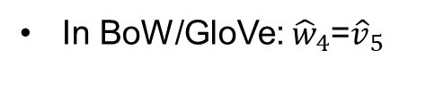




Transformers: Quick Motivation
Embeddings should be contextualized:
The embedding of the word should change with the context:
Example:
“The pie was good”
“The pie was not good”
Embedding for “good” should be different
$${\hat{w}}_{1}$$
$${\hat{w}}_{2}$$
$${\hat{w}}_{3}$$
$${\hat{w}}_{4}$$
$${\hat{v}}_{1}$$
$${\hat{v}}_{2}$$
$${\hat{v}}_{3}$$
$${\hat{v}}_{4}$$
$${\hat{v}}_{5}$$
In BoW/GloVe: ${\hat{w}}_{4}$=${\hat{v}}_{5}$
?
?
The pie was good
The pie was not good

Slide 41
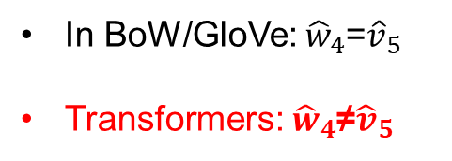
Transformers: Quick Motivation
Embeddings should be contextualized:
The embedding of the word should change with the context:
Example:
“The pie was good”
“The pie was not good”
Embedding for “good” should be different
$${\hat{w}}_{1}$$
$${\hat{w}}_{2}$$
$${\hat{w}}_{3}$$
$${\hat{w}}_{4}$$
$${\hat{v}}_{1}$$
$${\hat{v}}_{2}$$
$${\hat{v}}_{3}$$
$${\hat{v}}_{4}$$
$${\hat{v}}_{5}$$
In BoW/GloVe: ${\hat{w}}_{4}$=${\hat{v}}_{5}$
Transformers: ${\hat{w}}_{4}$≠${\hat{v}}_{5}$
Transformer
Transformer
The pie was good
The pie was not good

Slide 42
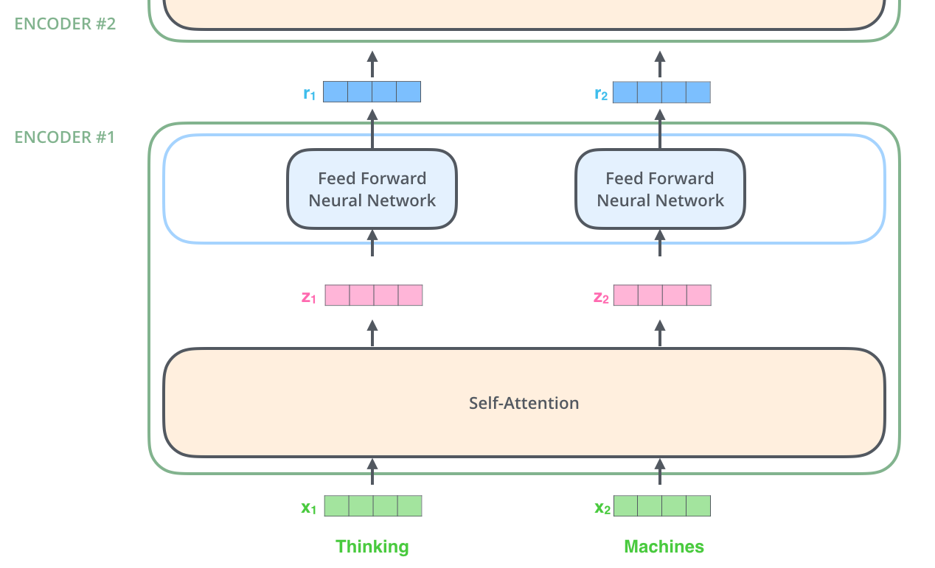
Transformer: Self Attention
Input: Non-contextual word embedding
Output: Contextual word embeddings
Self-Attention
Input Embeddings
Figures: Source

Slide 43
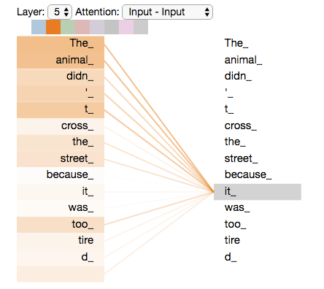
Transformer: Self Attention
“The animal didn’t cross the street because it was too tired”
Assume we want to determine the contextual embeddings of “it”
Which input words should we pay more attention to?
Self-Attention
Input Embeddings
Figures: Source

Slide 44
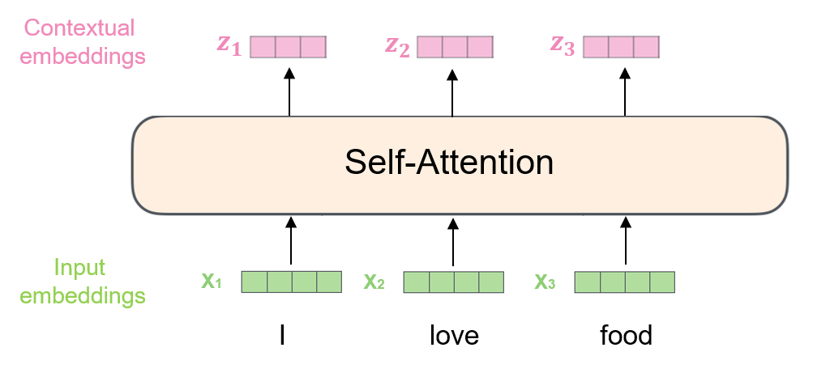
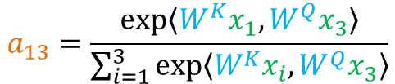
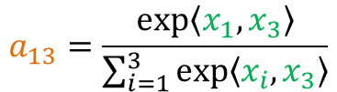

Transformer: Self Attention
$W^{Q}$, $W^{K}$, $W^{V}$: Trainable params
Attention Matrix
$$a_{13}=\frac{exp⁡\left\langle W^{K}x_{1},{W^{Q}x}_{3}\right\rangle }{\sum_{i=1}^{3}{exp⁡\left\langle {W^{K}x}_{i},{W^{Q}x}_{3}\right\rangle }}$$
$$a_{13}=\frac{exp⁡\left\langle x_{1},x_{3}\right\rangle }{\sum_{i=1}^{3}{exp⁡\left\langle x_{i},x_{3}\right\rangle }}$$
 | I | love | food
I | 0.6 | 0.3 | 0.1
love | 0.3 | 0.4 | 0.2
food | 0.1 | 0.2 | 0.5
$$z_{1}=W^{V}⋅(a_{11}⋅x_{1}+a_{12}⋅x_{2}+a_{13}⋅x_{3})$$

Slide 45

Transformer: Self Attention
Trainable parameters
$W^{Q}$,$W^{K}$,$W^{V}$
Self-Attention
Input Embeddings
Figures: Source

Slide 46
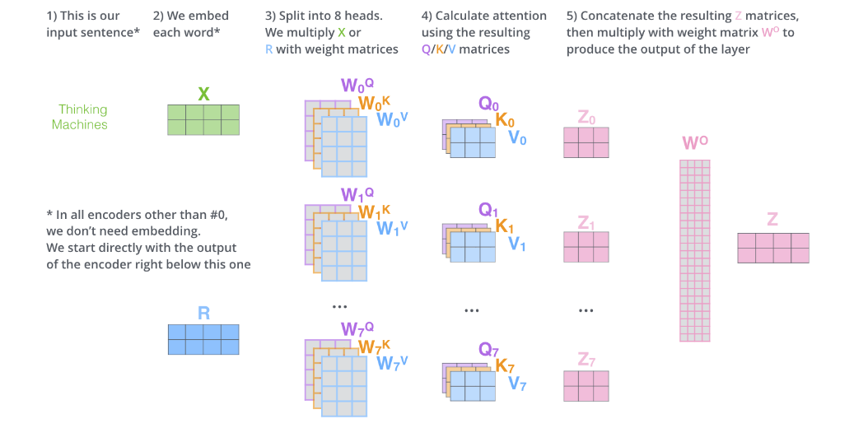
Transformer: Multi-head Attention
Multiple attention heads!
Figures: Source

Slide 47
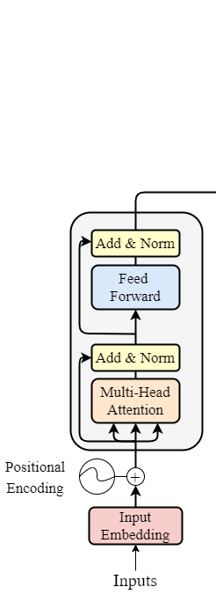
Transformer Encoder

Slide 48
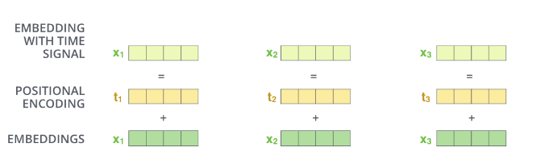
Back to NLP: Encode position
Before passing original embeddings from the transformer:
Add fixed positional embeddings
Encode the position of the word in the sentence

Slide 49
Transformer: Benefits
Unlike BoW/GloVe → Transformer embeddings account for:
Context
Word order
Unlike RNNs → Transformers:
Process input in parallel
Examine dependencies between all pairs of words
Don’t “forget” longer sequencies

Slide 50
2013-2014
Ways for creating dense low-dimensional word embeddings
2017
Superseded RNNs and completely took over the field of NLP
2018
Generative Pretrained Transformer which is the first ancestor of ChatGPT
Bag of Words
Word2Vec/ GloVe
RNNs
Transformers
BERT
GPT-1
1954
Very simple and contextless way of vectorizing text
~2015
Introduced in early 90’s but took off in mid 2010s due to DL advances
2018
Transformer-based architecutres for high-quality, contextualized embeddings

Slide 51
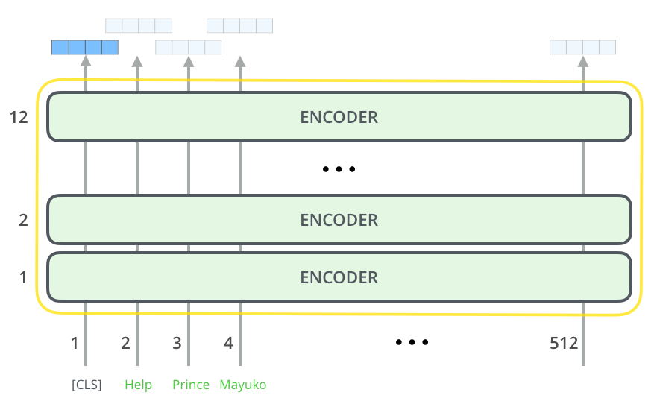
BERT
Bidirectional Encoder Representation from Transformers
Developed by Google (2018)
Architecture with multiple transformer encoders
Pretrained in massive amounts of text through:
Masked Language Modeling
Next Sentence Prediction
Can produce contextualized embeddings for:
Individual words
The whole sentence/text

Slide 52
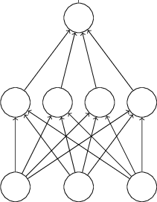

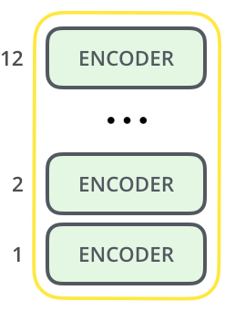
BERT for text classification
Positive/negative
Trainable
Method 1:
Use BERT to produce embeddings
Train Neural Network to predict label from embeddings
Embedding
The movie was bad

Slide 53
BERT for text classification
Positive/negative
Method 2:
Use BERT to produce embeddings
Train both BERT+CLS head
Transfer learning
Trainable
Embedding
The movie was bad

Slide 54
Colab
Link

Slide 55
Appendix

Slide 56
